Slide 1

Programming with arrays

Slide 2

Array methoden

Slide 3

Using the BinarySearch(), Sort(),and Reverse() Methods
System.Array class contains a variety of useful, built-in methods that can search, sort, and manipulate array elements

Slide 4
Using the Reverse() Method
Reverse() method
Reverses the order of items in an array
Element that starts in position 0 is relocated to position Length – 1
Use it by passing the array name to the method

Slide 5
Using the Reverse() Method
int[] ages = { 35, 67, 31, 57, 100 };
Array.Reverse(ages);
for (int i = 0; i < ages.Length; i++)
{
Console.WriteLine(ages[i]);
}

Slide 6

Using the Sort() Method
Sort() method
Arranges array items in ascending order
Use it by passing the array name to Array.Sort()

Slide 7
Using the Sort() Method (cont'd.)
string[] names = { "Tim", "Marie", "Abdul", "Bob" };
Array.Sort(names);
for (int i = 0; i < names.Length; i++)
{
Console.WriteLine(names[i]);
}

Slide 8

Using the BinarySearch() Method
BinarySearch() method
Finds a requested value in a sorted array
Member of the System.Array class
Do not use BinarySearch() under these circumstances
If your array items are not arranged in ascending order
If your array holds duplicate values and you want to find all of them
If you want to find a range match rather than an exact match

Slide 9
Using the BinarySearch() Method
int[] rank = { 224, 34, 156, 1023, -6 };
Array.Sort(rank); //don’t forget this if numbers aren’t sorted
Console.WriteLine("What rank do you need?");
int userchoice = Convert.ToInt32(Console.ReadLine());
int index = Array.BinarySearch(rank, userchoice);
if(index>0)
Console.WriteLine($"{userchoice} found at index {index}");
else
Console.WriteLine("Not found");

Slide 10
Other usefull Array stuff
Check out other Array.xxxx methods, such as:
.Clear()
.Copy(src, dest, length)

Slide 11
Strings and char arrays

Slide 12
Strings and arrays
String = array of chars
We can convert in both ways:
String to char-array: .ToCharArray();
Char-array to string: using new String(…);

Slide 13
String -> char-array
What will be the output?
string origineleZin = "Ik ben Tom";
char[] karakters = origineleZin.ToCharArray();
karakters[8] = 'i';
string nieuweZin = new string(karakters);
Console.WriteLine(nieuweZin);

Slide 14
Char-array -> string
What will be the output?
char[] arrayOfLetters = { 'h', 'a', 'l', 'l', 'o' };
arrayOfLetters[2] = 'x';
string word = new string(arrayOfLetters);
Console.WriteLine(word);

Slide 15
Searching in array

Slide 16
Searching an Array Using a Loop
Searching options
Using a for loop
Using a while loop

Slide 17
Using a for Loop to Search an Array
Use a for statement to loop through the array
Set a Boolean variable to true when a match is found
Solution is valid even with parallel arrays

Slide 18
Using a for Loop to Search an Array
string[] products = { "apples", "pears", "melons" };
double[] prices = { 3.3, 6.2, 2.9 };
Console.WriteLine("Which price do you need?");
string userchoice = Console.ReadLine();
bool found = false;
int productIndex = -1;
for (int i = 0; i < products.Length; i++)
{
if(products[i]== userchoice)
{
found = true;
productIndex = i;
}
}
if(found==true)
{
Console.WriteLine($"Price for {userchoice} is {prices[productIndex]}");
}
else
{
Console.WriteLine("Not found");
}

Slide 19
Using a while Loop to Search an Array
Use a while loop to search for a match
Question: why use a while instead of a for?

Slide 20
Using a for Loop to Search an Array
string[] products = { "apples", "pears", "melons" };
double[] prices = { 3.3, 6.2, 2.9 };
Console.WriteLine("Which price do you need?");
string userchoice = Console.ReadLine();
bool found = false;
int productIndex = -1;
int counter = 0;
while (counter < products.Length && userchoice != products[counter])
{
counter++;
}
if (counter != products.Length)//product found!
{
found = true;
productIndex = counter;
}
if (found == true)
{
Console.WriteLine($"Price for {userchoice} is {prices[productIndex]}");
}
else
{
Console.WriteLine("Not found");
}

Slide 21
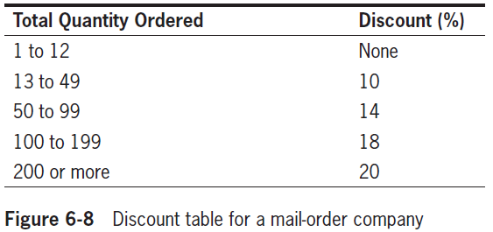
Searching an Array for a Range Match
Range match
Determines the pair of limiting values between which a value falls

Slide 22
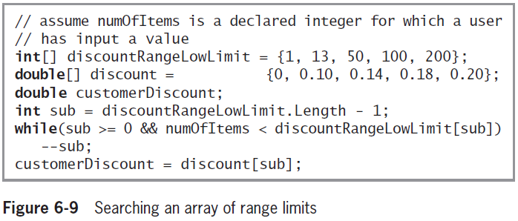
Searching an Array for a Range Match (cont'd.)

Slide 23


Summary
An array is a list of data items
All of which have the same type and the same name
Items are distinguished using a subscript or index
In C#, arrays are objects of a class named System.Array
The power of arrays becomes apparent when you begin to use subscripts
Subscript you use remains in the range of 0 through length -1
You can compare a variable to a list of values in an array

Slide 24
Summary (cont'd.)
The BinarySearch() method finds a requested value in a sorted array
The Sort() method arranges array items in ascending order
The Reverse() method reverses the order of items in an array

